Slide 1
Teradata University Network
2019 Data Challenge
Hajra Intikhab
Eunice Arthur-Gyamfi
Je’Juan Hunter
Zakiya Stith
Micah Quarles

Slide 2

Introduction
Analyze a non-profit organization’s data to answer business question and provide actionable findings we would recommend.
Notes:
Eunice

Slide 3
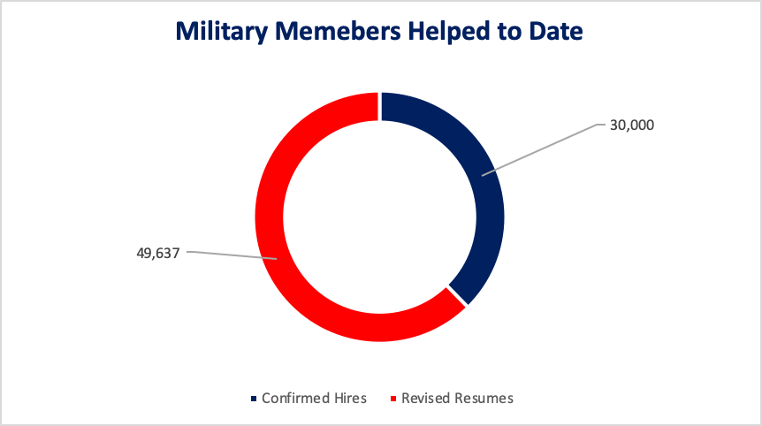
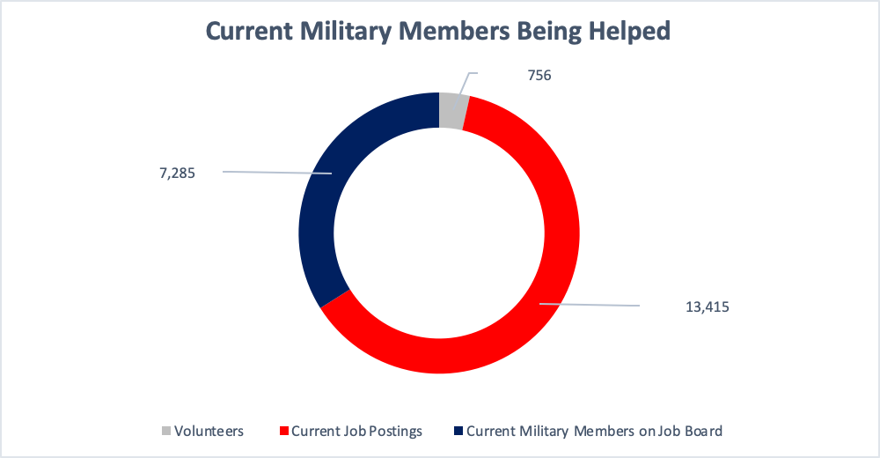
Problem & Motivation
Focused on the developmental aspect of Hire Heroes
Would cease to exist without continuous volunteer support and donations
Notes:
Eunice

Slide 4

Problem & Motivation Cont.
Three developmental factors:
Geographic location
Lifespan of Donors
Unsolicited Donors

Slide 5
Approach
The first thing our team did was to research Hire Heroes USA to gain a better understanding of the business, their mission, goals, and demographics.
This allowed us to tailor our thought process to find solutions that were aligned with this company's goals.
With a firm understanding of what this company does we decided that focusing on the developmental aspect of the this business was the most beneficial.
Notes:
Hajra

Slide 6
Approach Continued
Analyzing where donors were located and their gifting patterns allowed our team to make recommendations the can help this company to continue help the military community and grow to help even more.
Notes:
hajra

Slide 7
Tools & Analytics
Tableau Prep
Microsoft Excel Pivot Tables
Mapchart.net

Slide 8
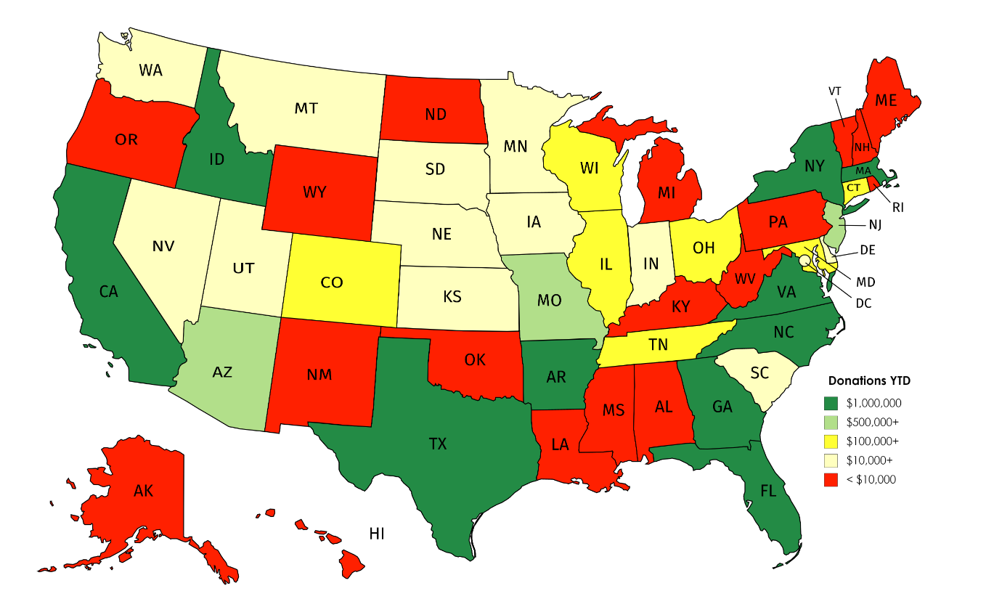
Results
Soliciting bigger market states= more donations
Data helped Identify which geographical areas to focus on
Notes:
JEJUAN

